Slide 1
AICA MINI PROJECT
Travel Recommendation System
Name:-Jeshan Savani P.
Enrollment No:-26D2DAI005

Slide 2
1. Aim and Objectives
Aim: Recommend destinations that match the user's preferred travel type.
This project uses Prolog to recommend destinations based on a travel category chosen by the user. The program checks a small knowledge base and returns places that match the selected category.
AICA MINI PROJECT | TRAVEL RECOMMENDATION SYSTEM
1

Slide 3
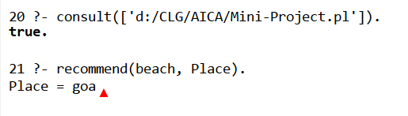
2. Prolog Code
Query:-
recommend(beach, Place).
place(goa, beach).
place(diu, beach).
place(manali, mountains).
place(munnar, mountains).
place(jaipur, heritage).
place(udaipur, heritage).
recommend(Type, Destination) :-
place(Destination, Type).
Possible output:-
AICA MINI PROJECT | TRAVEL RECOMMENDATION SYSTEM
2

Slide 4
3. Depth First Search (DFS)
Depth First Search explores one branch as far as possible before returning to try another branch. It is commonly implemented using recursion or a stack.
How it works
Key points
Start at the root node.
Visit an unvisited child.
Continue deeper until stuck.
Backtrack and try another branch.
Uses a stack (LIFO) or recursion
Does not always find the shortest path
Useful for graph and maze traversal
AICA MINI PROJECT | TRAVEL RECOMMENDATION SYSTEM
3

Slide 5
4. DFS Diagram and Example
A
B
C
D
E
F
G
Example traversal: A → B → D → E → C → F → G
DFS goes down A–B–D first. D has no child, so it backtracks to B, visits E, then returns to A and explores C.
AICA MINI PROJECT | TRAVEL RECOMMENDATION SYSTEM
4

Slide 6
5. DFS Algorithm (Simple)
DFS(node):
mark node as visited
print node
for each unvisited neighbour of node:
DFS(neighbour)
Example result
Starting at A and visiting left first:
A, B, D, E, C, F, G
AICA MINI PROJECT | TRAVEL RECOMMENDATION SYSTEM
5

Slide 7
6. Conclusion
This project shows how Prolog facts and rules can match a travel category with suitable destinations. The DFS section explains a separate AI search technique from the syllabus; it is not part of the current recommendation code.
Thank you
AICA MINI PROJECT | TRAVEL RECOMMENDATION SYSTEM
6

